Slide 1
Career Development Training Course
Career Waypoints
Professional Apprenticeship Career Track (PACT)

Slide 2
Enabling Objectives
STATE the purpose of Career Waypoints.
LIST the personnel impacted by the Career Waypoints process.
IDENTIFY the Career Waypoints modules.
LIST the Career Waypoints options provided to the Sailor.
ASSESS the Career Waypoints timeline requirements.
EXPLAIN the PACT Marketplace process.
EXPLAIN the submission process for 4-2-2 Sailors.
Notes:
FACILITATOR GUIDE:
Review objectives.

Slide 3
References
Navy Military Personnel Manual, NAVPERS 15560 (series)
MILPERSMAN 1160-140, Career Waypoints
MILPERSMAN 1001-260, Targeted Re-Entry Program
NAVPERS 15878 (series), Career Counselor Handbook
Career Waypoints (CWAY) User Guide
Career Waypoints PACT Marketplace Submission Schedule (FY)
MILPERSMAN 1306-611, Professional Apprenticeship Career Track (PACT)
DCNO SIGNED MEMO SER N1/114087, Military Service Obligation
MILPERSMAN 1236-010, Armed Forces Classification Test (AFCT) Administration and Procedures for Navy Personnel
Notes:
FACILITATOR GUIDE:
Review references.

Slide 4
Primary Purposes of Career Waypoints (CWAY)
Qualifying and adjudicating civilians into the Navy as enlisted Sailors.
Controlling enlisted rating entry standards.
Providing Sailor qualifications for MyNavy Assignments (MNA) marketplace to best place Sailors into billets and/or conversion into desired rate.
Allow Sailors to execute obligated service in line with PCS orders.
Notes:
FACILITATOR GUIDE:
Career waypoints (CWAY) is a force shaping tool which assists with balancing manning across rates, ratings through BUPERS control of reenlistment and enlistment contract extension quotas.
It provides conversion opportunities within MNA
NOTE: Sailors can now apply for conversion in the Marketplace located in My Navy Assignment (MNA). (preferred method)

Slide 5
CWAY Guidance
All Sailors (AC/TAR/SELRES) E1-E9 must be qualified in C-Way upon reporting to the command.
  CCC's can utilize NP 1040/4
All Sailors must have CO retention recommendation updated upon any changes.
  E1-E9 must be recommended for retention in order to apply for OBLISERV within MNA.
Active Duty Sailors can apply to affiliate with the Selected Reserves between 10 months to 90 days prior to their SEAOS. (see mandatory Reserve affiliation for 4-2-2 sailors with remaining MSO requirements)
Selected Reserve Sailors:
  Can apply for lateral conversions
  Apply to change from Reserve Component to Active Component
Notes:
FACILITATOR GUIDE:
CWAY is also where you go if a Sailor decides to transition from Active Component to Selective Reserves or vice versa.

Slide 6
CWAY Guidance (cont)
Review and/or submit applications for all required personnel monthly.
Update your Sailor’s career intentions and applications appropriately.
Ensure PACT Marketplace is updated with Sailors intentions prior to submission deadline.
TRP applications must be submitted within 4-16 months from SEAOS.
  Must have completed their 8-year MSO requirement but have no more than 14 years on active duty.
Encourage Sailors to use the CEM function and complete the JOIN survey to assist them in getting desired jobs.
Notes:
FACILITATOR GUIDE:
Each Sailor attached in your command be must be QUALIFIED in CWAY.
Deadline for application submission is 2359 Central Standard Time on the last day of each month. As the CCC, ensure to check all your CWAY application browser to ensure that there nothing is generated in CWAY prior to that date. (e.g., If a servicemember loses Security clearance, the Sailor may get flagged in CWAY and an application might revert requiring your attention.)

Slide 7
Other C-WAY Modules
Job Opportunities in the Navy (JOIN)
  Allow Sailors to complete survey to determine career interest.
  Ranks each job based on survey inputs.
Career Exploration Module (CEM)
  Great tool when conducting conversion CDB’s.
  Allows counselors to identify and explain why a Sailor did not qualify for a particular rate.
Notes:
FACILITATOR GUIDE:
1. Join is a job interest assessment tool that supports recruits and Sailors making rating entry decisions.
2. CEM assists in determining correctable deficiencies that would otherwise render Sailors ineligible for desired ratings (e.g., retake the Armed Forces Classification Test (AFCT)- the in-service version of the ASVAB). The CEM module also provides Sailors with a roadmap for each job they qualify for.
3. Both of the above modules, can be found in the CWAY self-service system via BOL (under my opportunities and my interest).

Slide 8
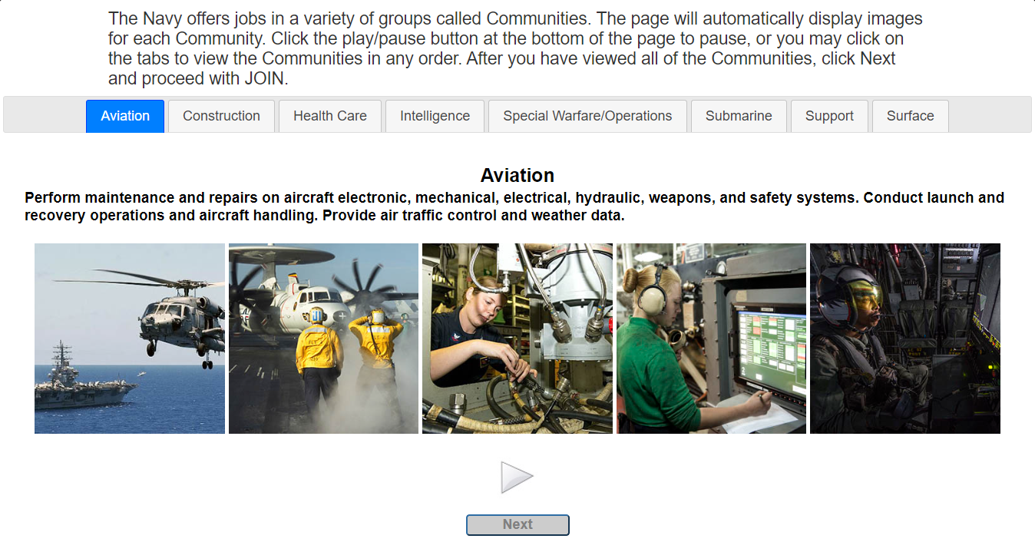
Job Opportunities in the Navy (JOIN) Survey
Notes:
FACILITATOR GUIDE:
Access via BOL. Great tool to assess interest and ranking of rates.

Slide 9
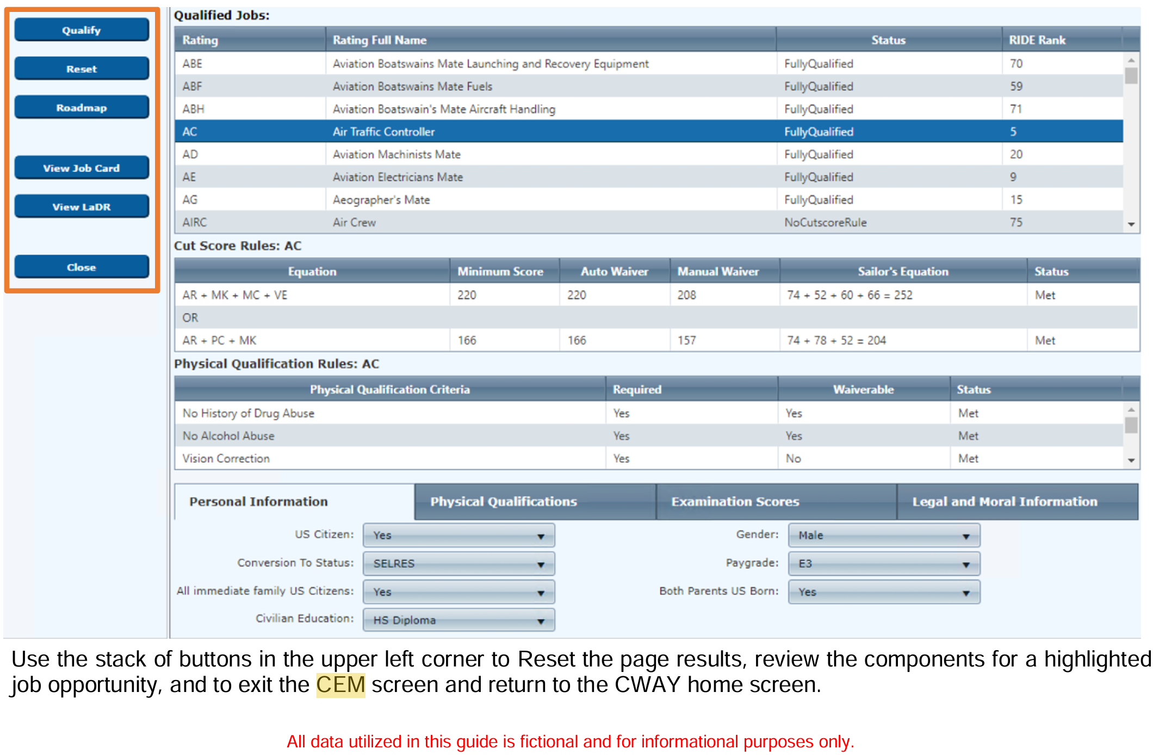
Career Exploration Module
Notes:
FACILITATOR GUIDE:
Review CEM module
• Qualify populates the Qualified Jobs field after you have entered your selections in the Personal Information, Physical Qualifications, Examination Scores, and Legal and Moral Information tabs at the bottom of the window.
• Reset resets your entries under the Personal Information, Physical Qualifications, Examination Scores, and Legal and Moral Information tabs at the bottom of the window.
• Roadmap lists the Supplemental Qualifications, Examinations and Training Requirements Checklist, Requirements Not Met, and Qualification Steps necessary to qualify for the desired rating.
• Job Card gives a complete overview of the selected rating, showing the career path, job duties, working environment, and related civilian jobs.
• LaDR (Learning and Development Roadmap) outlines training and education milestones for each rating at each pay grade to optimize your Navy career path.
• Close exits the CEM and closes the window.

Slide 10
AFCT Retesting
MILPERSMAN 1236-010
CO authorization
Must show academic improvement by completing one of the following before retaking:
  Have H.S. diploma, GED, or passed the U. S. citizenship test
  Complete the Online Academic Skills Course (OASC) through DANTES
  Complete a college or correspondence course
New scores will be updated in the Enlisted Master File after processing.
The new AFCT test score is final and will replace the current ASVAB/AFCT test score.
Notes:
FACILITATOR GUIDE:
AFCT test results will be available in member's NSIPS within 30 days of testing. Personnel may retake the AFQT no less than 30 days from last test.
NOTE: The new AFCT score will overtake the current score.

Slide 11
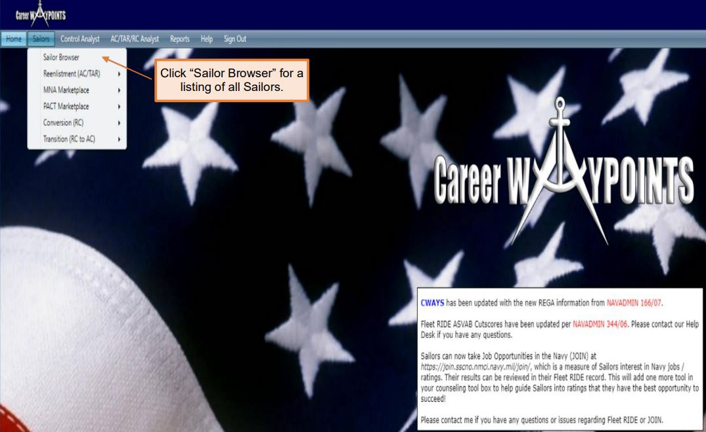
CWAY Sailor Browser
Notes:
FACILITATOR GUIDE:
1. Once logged into the home page for CWAY, (found on BOL) in the middle of the screening CWAY populates notes, i.e. if a specific month reenlistment results have been released or any other important information.
2. To pull individual Sailors, hover over Sailors, Sailor browser and find Sailor (listed in alphabetical order based off last name). To get to the reenlistment applications prepopulated for the month, hover over Sailors, reenlistment then click reenlistment application browser. Here you can see which Sailors' applications have been submitted. You can change the from/to date to a single month and click on the refresh button highlighted in blue.

Slide 12
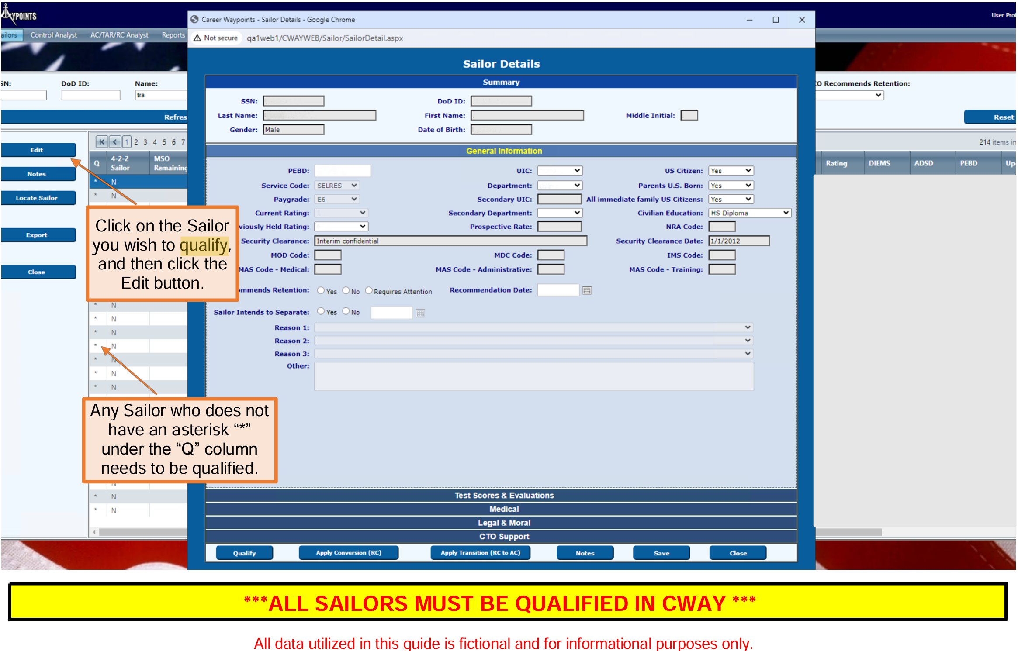
To Qualify a Sailor
Notes:
FACILITATOR GUIDE:
Each Sailor must be qualified in CWAY in order for the system optimization properly work. Ensure you are screening.
1. To qualify or manually input a reenlistment application, hover over Sailors, Sailor browser, find Sailor you are looking for, highlight in blue then click edit on left hand side. On this screen you will click on and ensure all information is correct for general information, test scores and evaluations, medical, legal & moral, and CTO (this portion you will leave blank unless a Sailor is close to separating and a CTO (Career Transition Officer) has been assigned.
Once updated and verified click on qualify (lower left corner). You will know if a Sailor is qualified or not, by going back to Sailor, Sailor browser. Here you will see the listing of all of your Sailors; there will be an asterisk (*) on the left side next to all Sailors who are qualified.
If you need to manually input a reenlistment application for a Sailor, you will go back to this screen and instead of clicking "qualify" click on apply reenlistment.

Slide 13
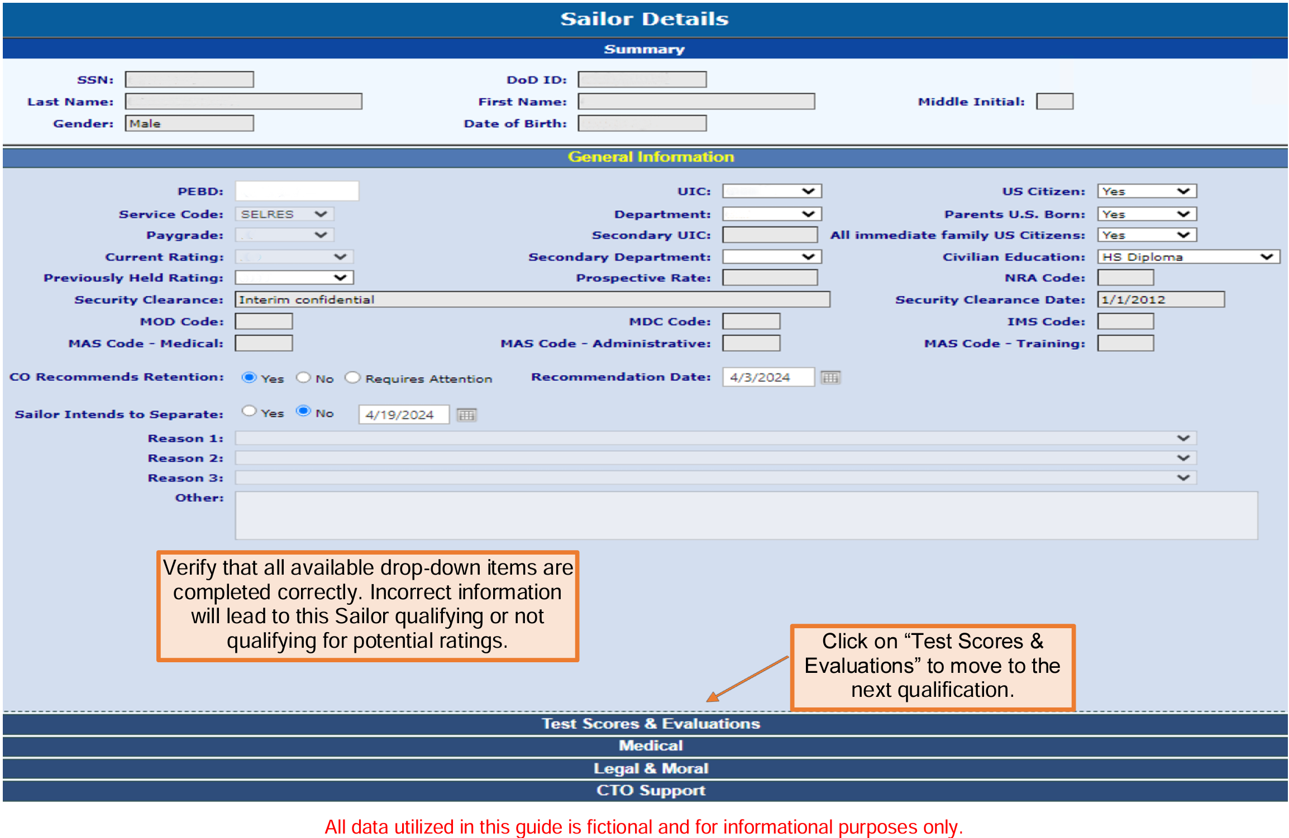
To Qualify a Sailor (cont’d)
Notes:
FACILITATOR GUIDE:
Each Sailor must be qualified in CWAY in order for the system optimization properly work. Ensure you are screening.
Go through each tab (Test Scores & Evaluations, Medical, etc), and ensure that the information is current and up-to-date before hitting Qualify.
Refer to the 2024 CWAY User Guide (page 18-23) for more examples and further guidance..

Slide 14
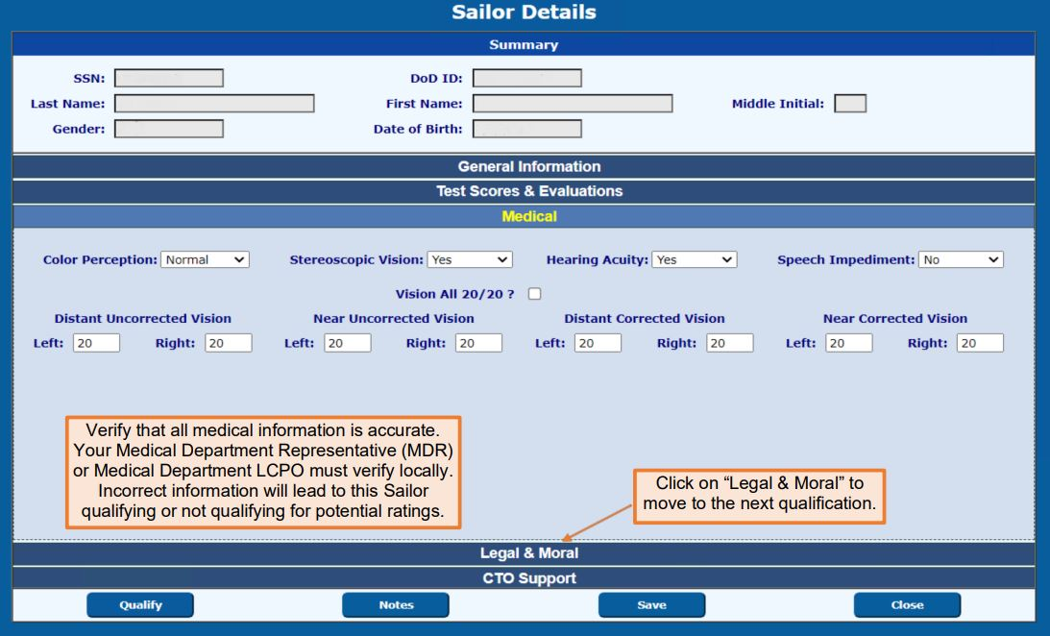
To Qualify a Sailor (cont’d)
Notes:
FACILITATOR GUIDE:
None

Slide 15
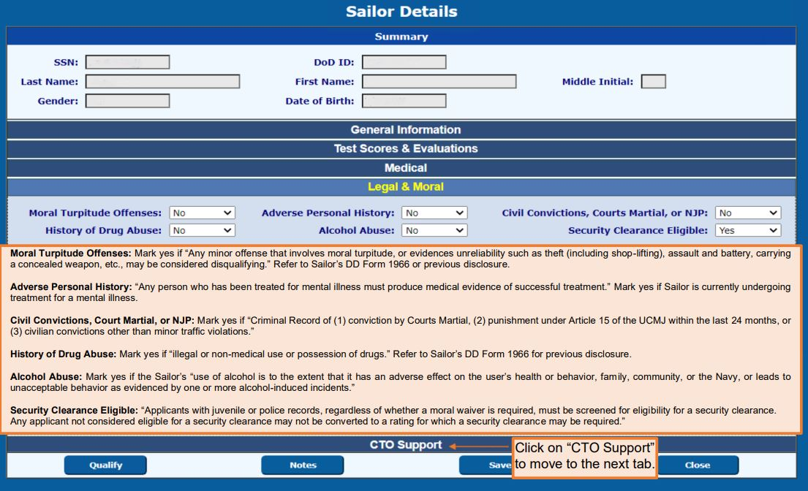
To Qualify a Sailor (cont’d)
Notes:
FACILITATOR GUIDE:
None

Slide 16
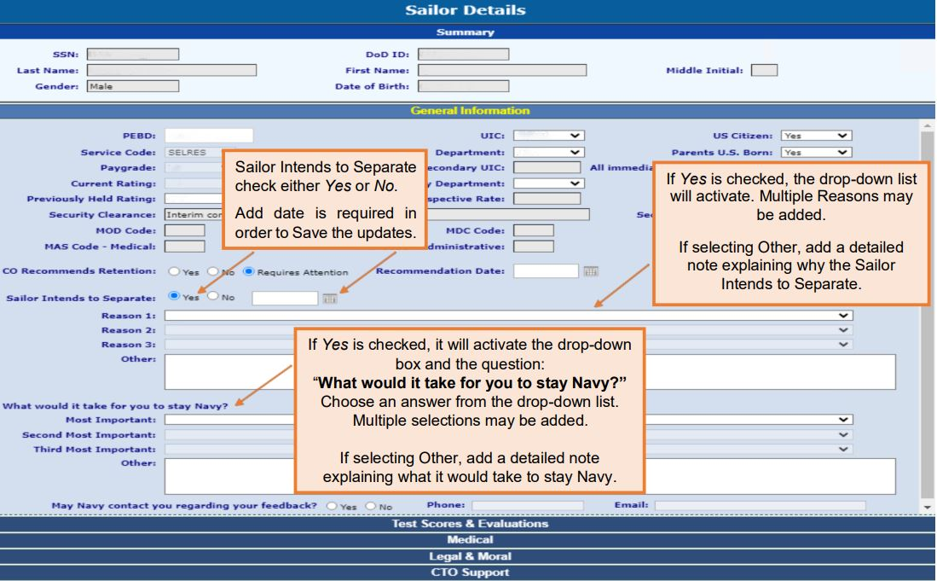
Updating Intentions to Separate
Notes:
FACILITATOR GUIDE:
None

Slide 17
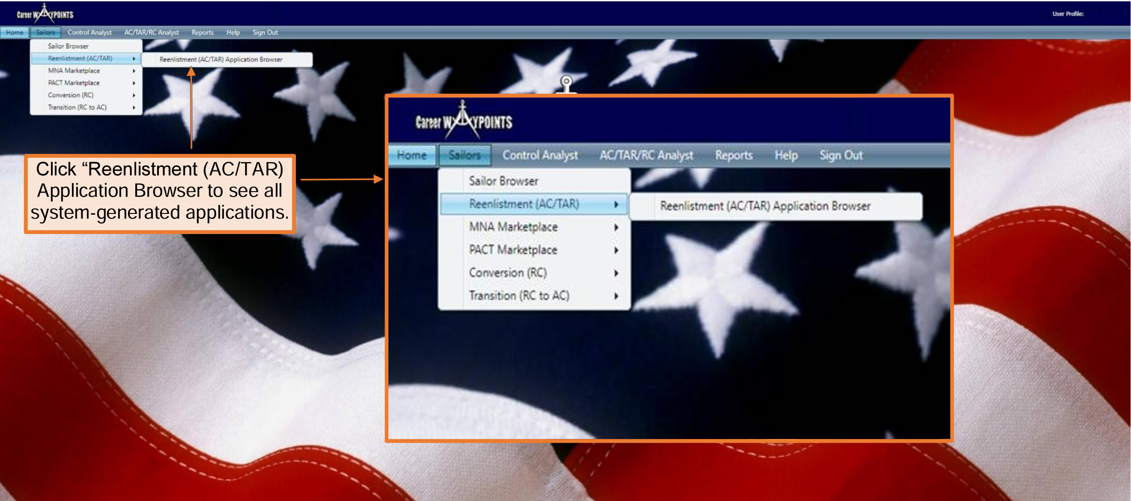
Submitting SELRES Application
Notes:
FACILITATOR GUIDE:
CWAY Application - Applies to Active Duty and TAR Sailors E3 to E6 with 14 years or less of active service between Active-Duty Service Date (ADSD) and Expiration of Active Obligated Service (SEAOS).
Applications can be submitted under either “Sailors > CWAY Application Browser” or “Sailors > Sailor Browser.”
Most CCCs utilize the “CWAY Application Browser” to submit CWAY applications. All system-generated applications can be found in this section.
AC/TAR Sailors applying for Reenlistment and Conversion apply in My Navy Assignments during their PRD window.

Slide 18
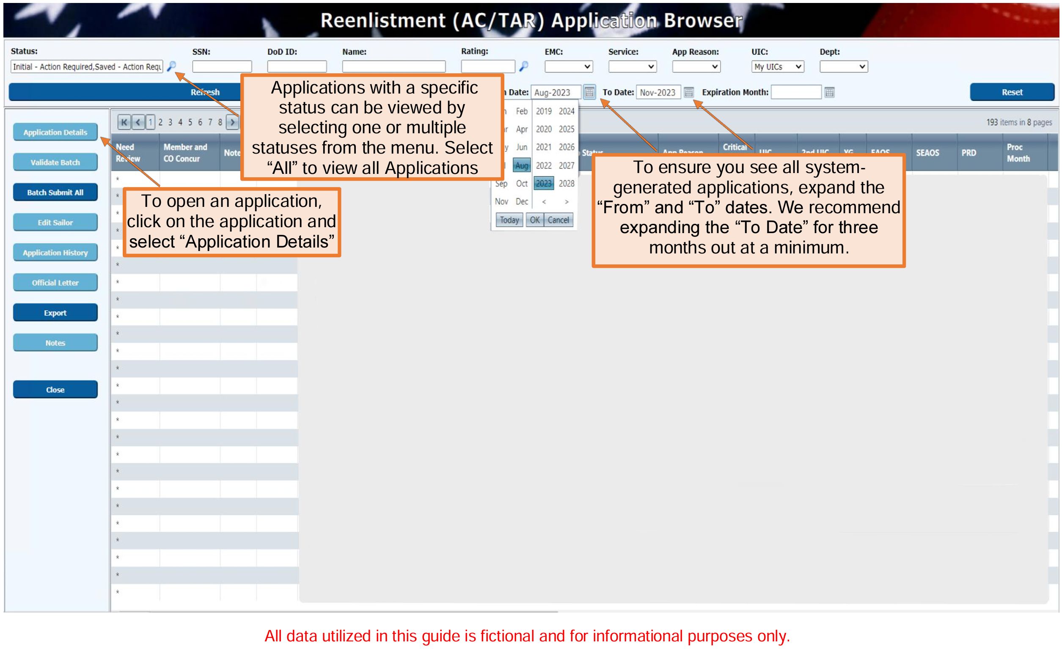
Submitting SELRES Application (cont’d.)
Notes:
FACILITATOR GUIDE:
Applications can be submitted under either “Sailors > CWAY Application Browser” or “Sailors > Sailor Browser.”
Most CCCs utilize the “CWAY Application Browser” to submit CWAY applications. All system-generated applications can be found in this section.
AC/TAR Sailors applying for Reenlistment and Conversion apply in My Navy Assignments during their PRD window.

Slide 19
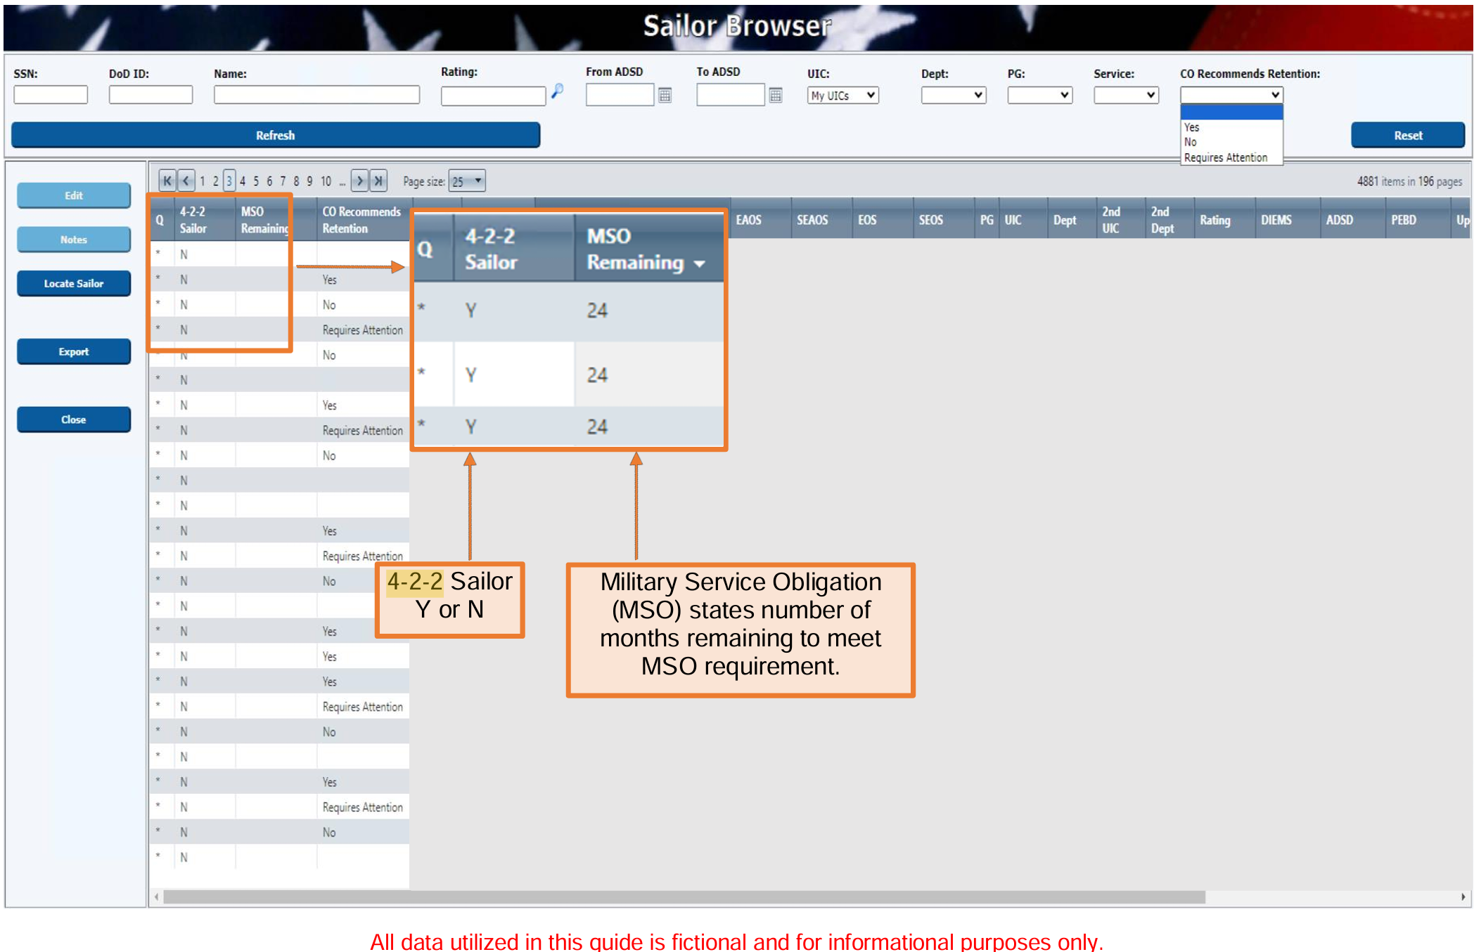
4-2-2 Sailor
Notes:
FACILITATOR GUIDE:
None

Slide 20
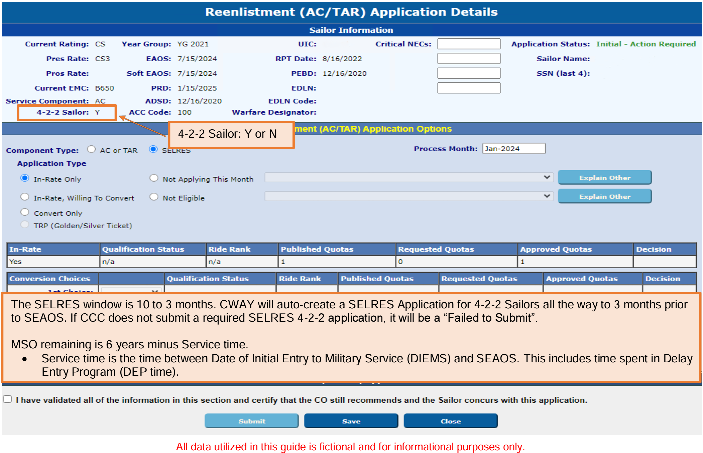
4-2-2 Sailor (Cont’d)
Notes:
FACILITATOR GUIDE:
None

Slide 21
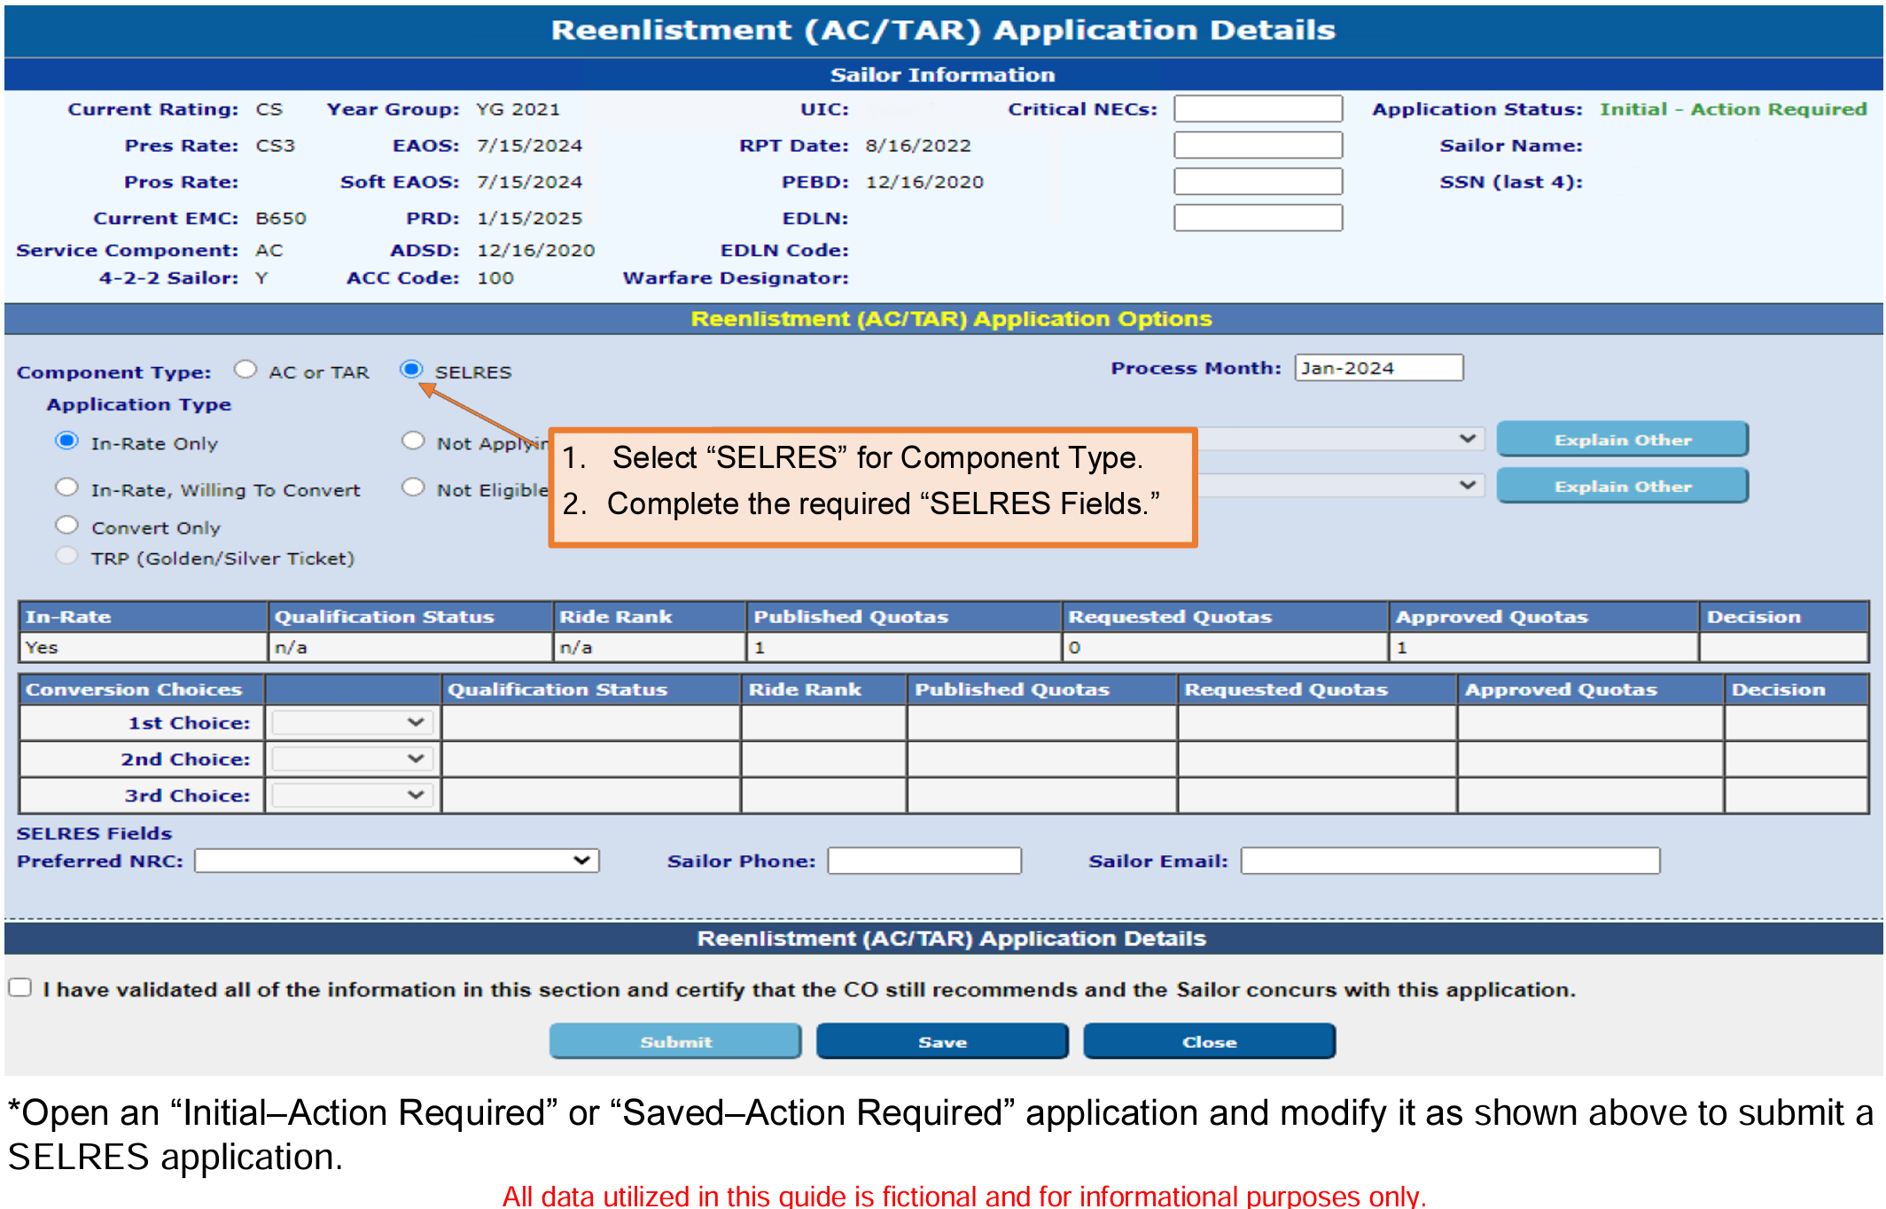
Non 4-2-2 SELRES Application
Notes:
FACILITATOR GUIDE:
Per MILPERSMAN 1306-1501, the CCC may contact the SELRES Enlisted Community Manager directly to request a SELRES quota (not a reset) for Sailors within 90 days from SEAOS. Resets for SELRES are NOT authorized during this period.

Slide 22
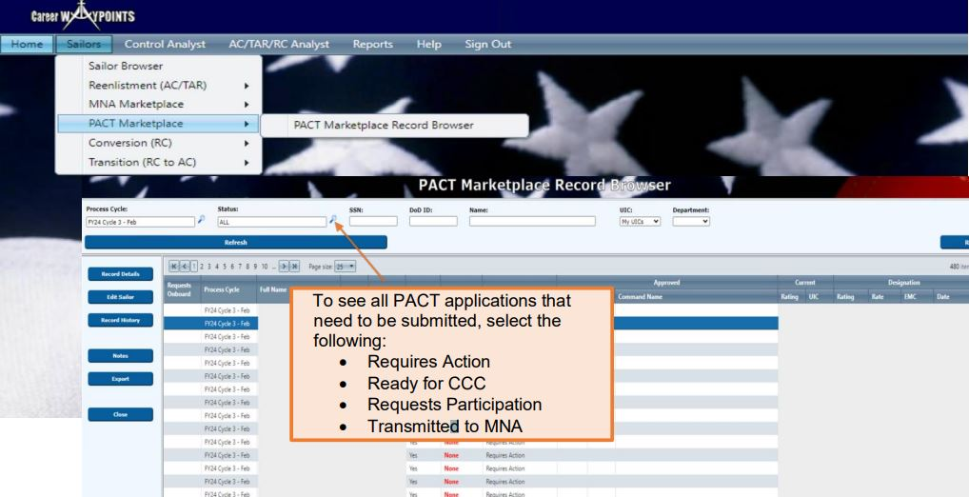
PACT Marketplace Record
Notes:
FACILITATOR GUIDE:
CWAY receives results from MNA Marketplace of Sailors who have been selected for a set of orders and approved for Reenlistment.

Slide 23
Status for PACT Marketplace
Requires Action
Ready for CCC
Requests Participation
Requests Onboard
Declines Participation
Not Eligible
Transmitted to MNA
Approved
Approved-Revoked
Denied
Notes:
FACILITATOR GUIDE:
• Requires Action - The record must be reviewed and updated with the Member’s desire/eligibility.
• Ready for CCC - DCC has entered the Member’s desire, and it is ready for CCC review and submission.
• Requests Participation - Member has requested to participate in PACT Marketplace.
• Requests Onboard - Member can request to remain onboard current command.
• Declines Participation - Member declined to participate in MNA PACT Marketplace.
• Not Eligible - Member is not eligible, for example, Legal/Moral disqualification, performance, etc.
• Transmitted to MNA - Member’s record sent to MNA with all Member’s qualified jobs.
• Approved - Member was approved for a rate and order via the MNA PACT Marketplace.
• Approved-Revoked - Previous approved rate and orders returned and/or revoked.
• Denied - Member’s request was denied during the cycle.

Slide 24
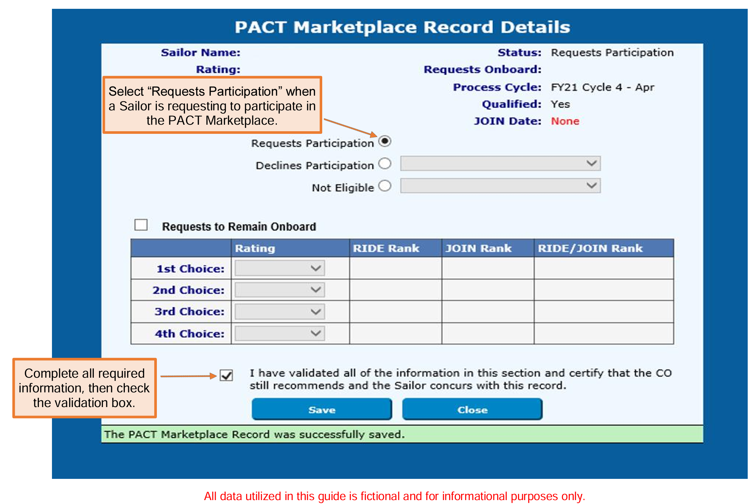
CWAY PACT Marketplace Record Detail Screen
Notes:
FACILITATOR GUIDE:
None

Slide 25
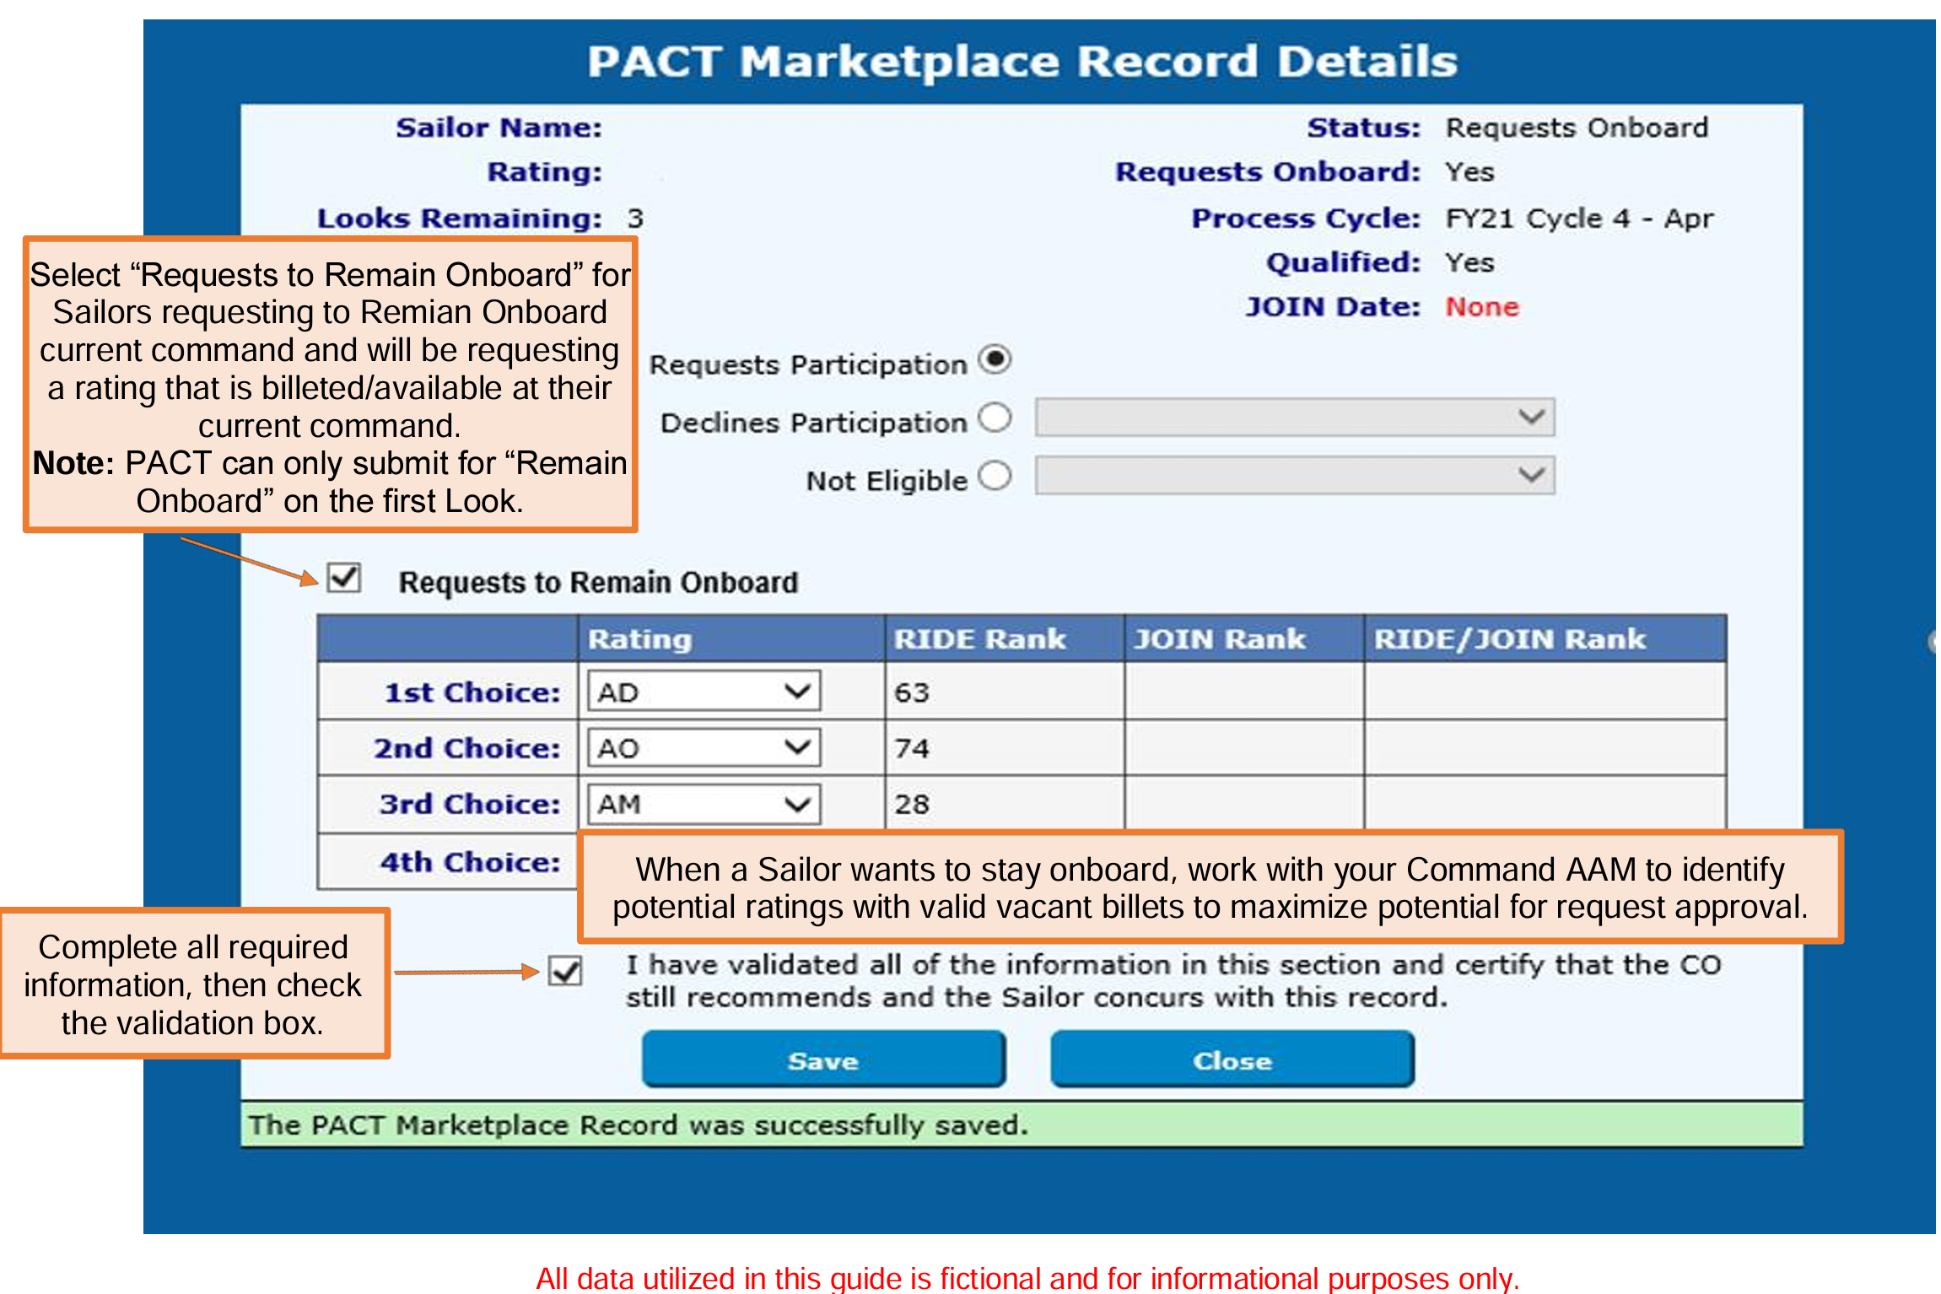
CWAY PACT Marketplace Record Detail Screen (Cont’d)
Notes:
FACILITATOR GUIDE:
None

Slide 26
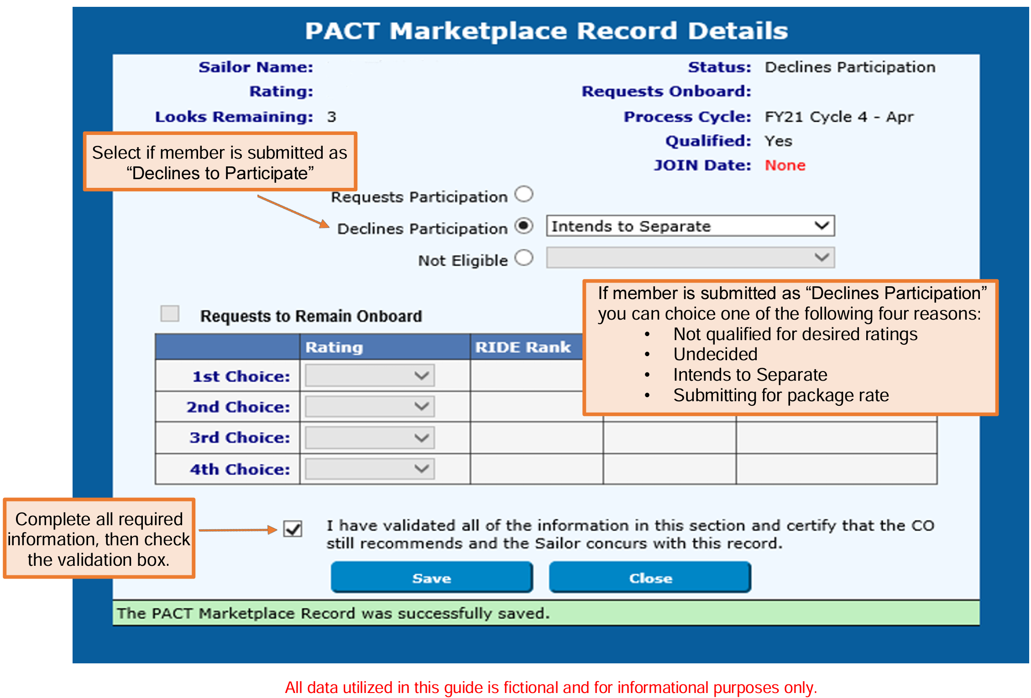
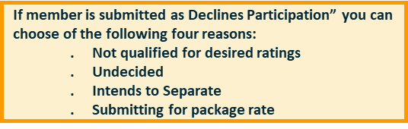
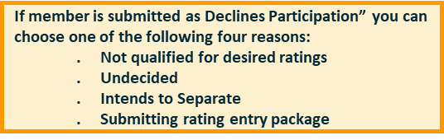
CWAY PACT Marketplace Record Detail Screen (Cont’d)
Notes:
FACILITATOR GUIDE:
None

Slide 27
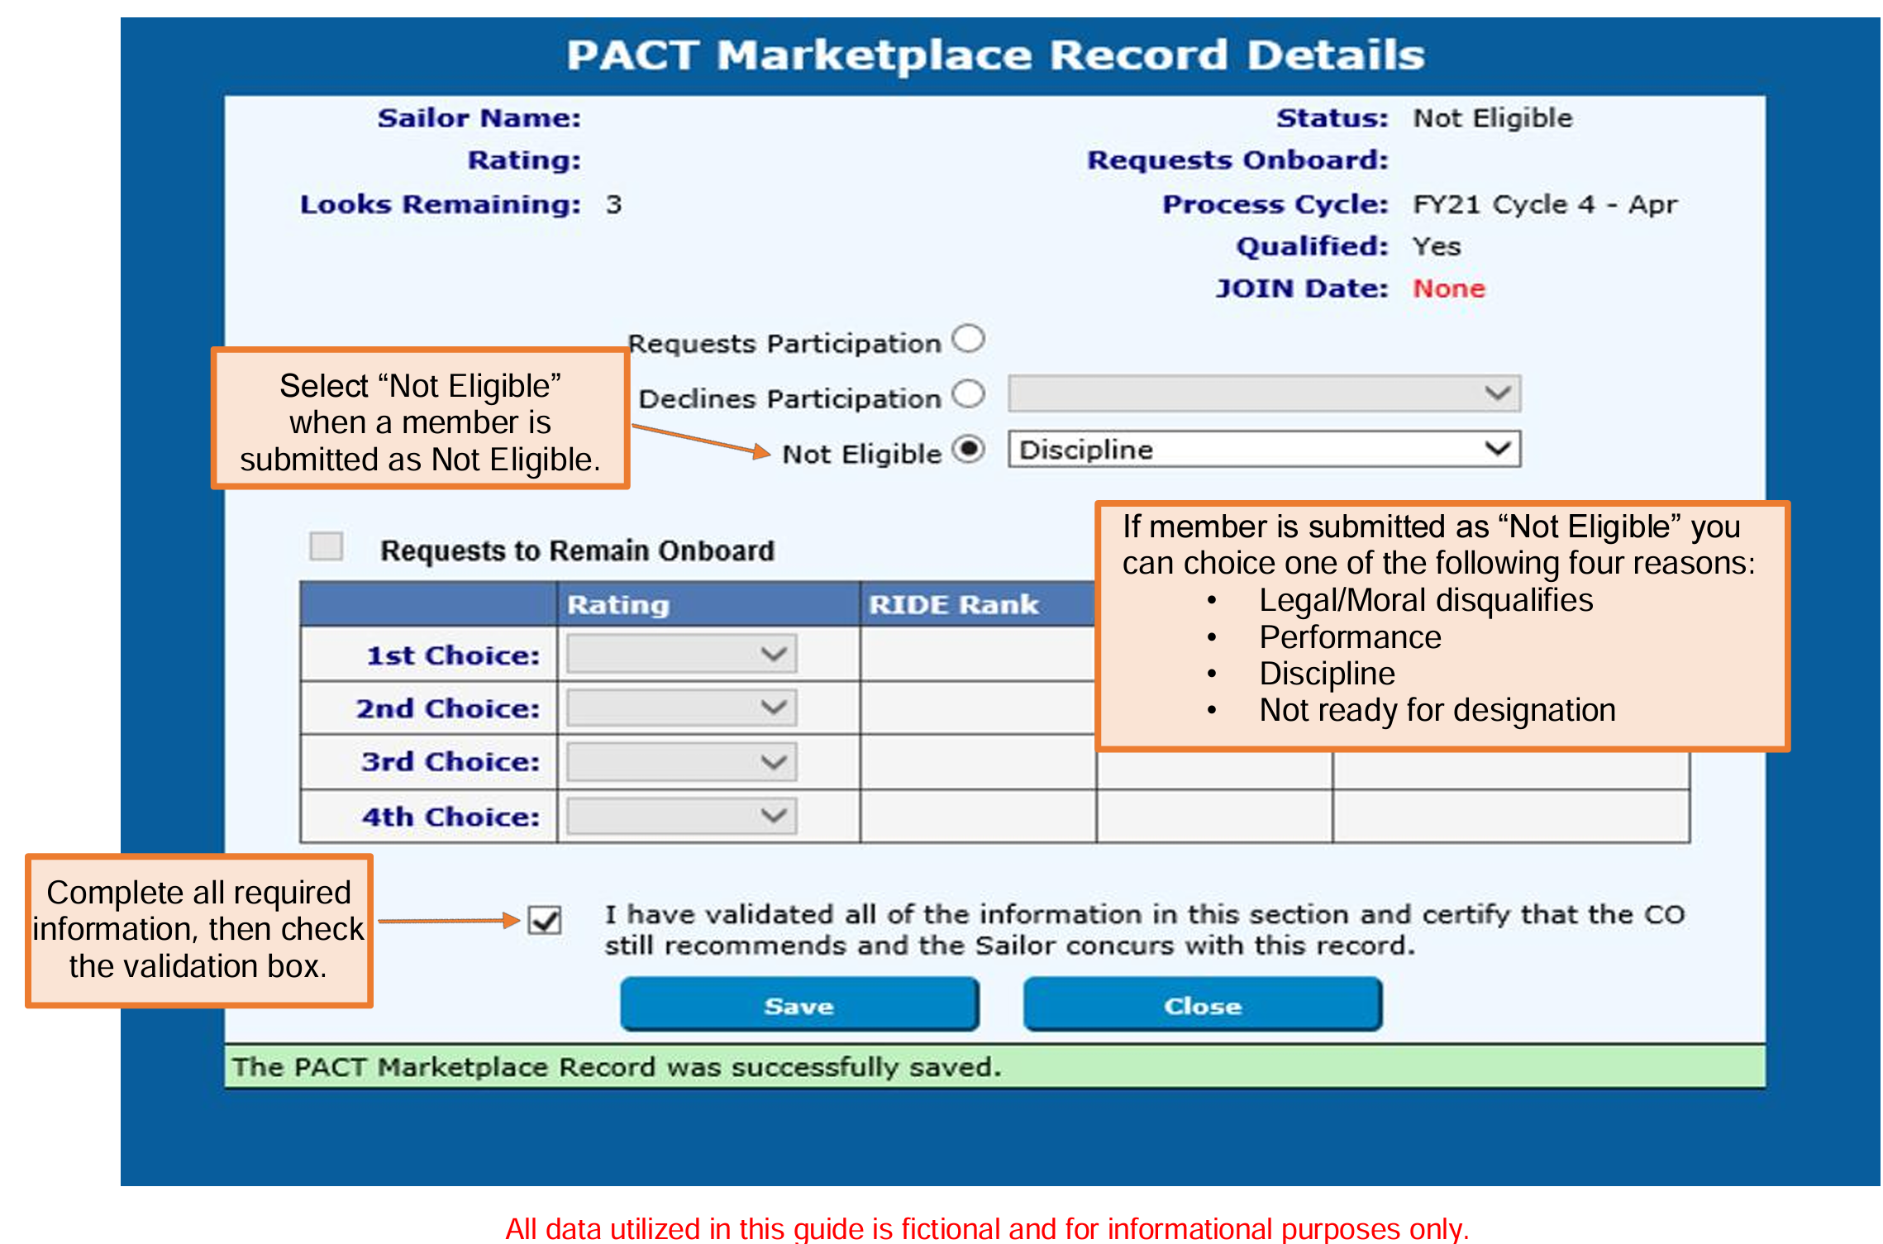
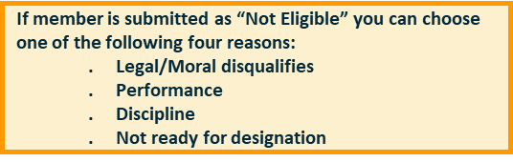
CWAY PACT Marketplace Record Detail Screen (Cont’d)
Notes:
FACILITATOR GUIDE:
None

Slide 28
PACT Notes
Be sure to check eligibility status monthly and make updates as soon as possible.
  For example, member cannot obtain security clearance due to not being a U.S. Citizen. Once member becomes a U.S. citizen, this must be updated in CWAY to render member eligible
Same applies for “declines participation”. If member changes their mind later, be sure updates are submitted prior to next MNA cycle.
Ensure to log into MyNavy HR and review the current PACT Marketplace Schedule for the FY.
Notes:
FACILITATOR GUIDE:
None

Slide 29
CWAY-TRANSITION for
RC to AC/TAR
Be SELRES at the time of application
  Retired Sailors and Sailors of the Individual Ready Reserve (IRR) are not eligible.
Be a satisfactory drill participant
Be designated to a rating
Have completed all requirements to make rate permanent for all temporary rating Reserve affiliation programs
Have completed any mandatory drilling obligations (i.e., NAT Sailors – restrictions are currently lifted)
Be able to meet prescribed enlisted age limitations for continuation set forth in MILPERSMAN 1160-010.
Meet physical readiness assessment standards IAW OPNAVINST 6110.1 (Series).
Meet requirements for reenlistment per NAVMED P-117, Manual of the Medical Department
Be eligible to reenlist for 48 months without exceeding the High Year Tenure (HYT) program limitations outlined in MILPERSMAN 1160-120 and NAVADMIN 143/17 (Waivers are authorized.)
Notes:
FACILITATOR GUIDE:
CWAY-TRANSITION for RC to AC/TAR
Refer to the latest CWAY User Guide to identify and explain the roles and responsibilities of each entities involved in the process to ensure proper and accurate transition from RC to AC. – 2024 CWAY User Guide (page 77-80)

Slide 30
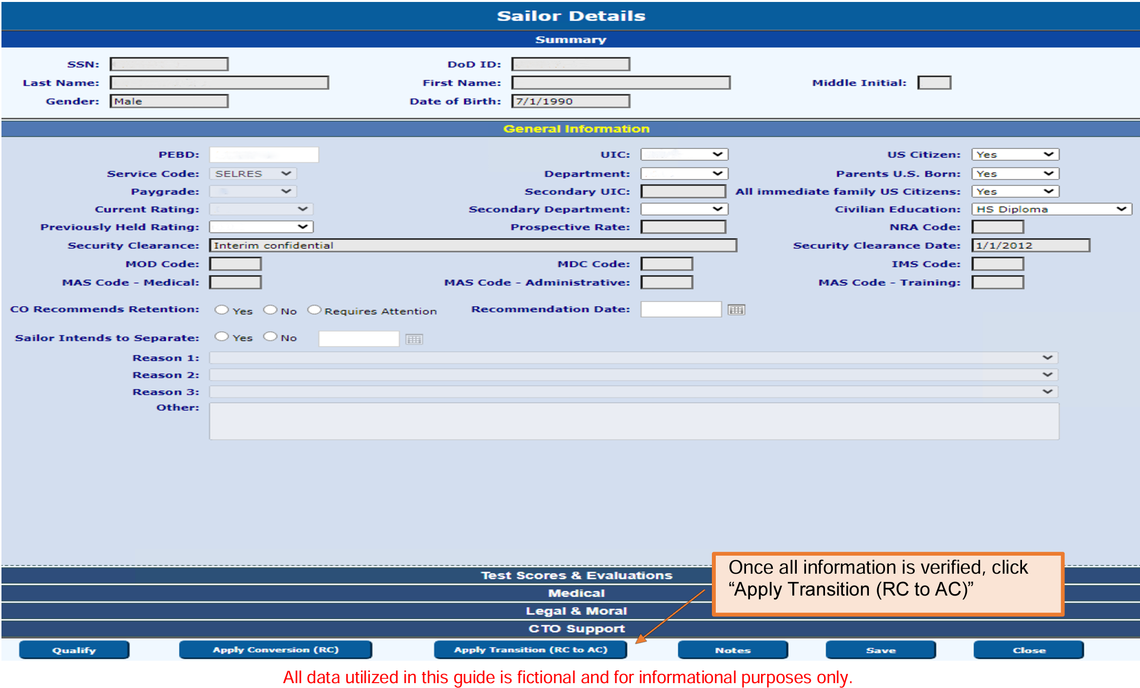
Submitting a
CWAY-TRANSITION Application for RC to AC/TAR
Notes:
FACILITATOR GUIDE:
Submitting CWAY-TRANSITION for RC to AC/TAR
To get to this page, go into your Sailor Browser and select the Sailor who desires to convert.
You must double-check the Sailor’s information to ensure he or she will be eligible for all ratings they truly qualify for.

Slide 31
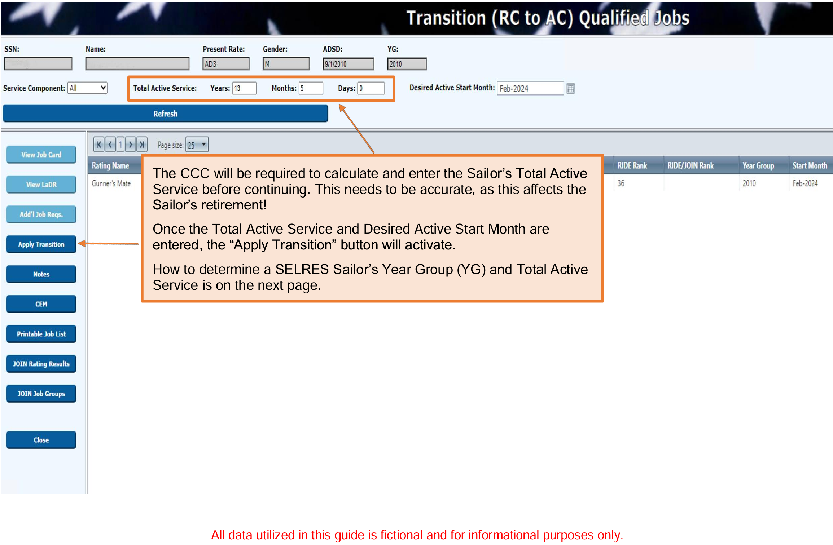
Submitting a CWAY-TRANS Application for RC to AC/TAR (Cont’d.)
Notes:
FACILITATOR GUIDE:
Submitting CWAY-TRANSITION for RC to AC/TAR
The CCC will be required to calculate and enter the Sailor’s Total Active Service before continuing.
This needs to be accurate, as this affects the Sailor’s retirement! Once the Total Active Service and Desired Active Start Month are entered, the “Apply Transition” button will activate.
How to determine a SELRES Sailor’s Year Group (YG) and Total Active Service is on the next page.

Slide 32
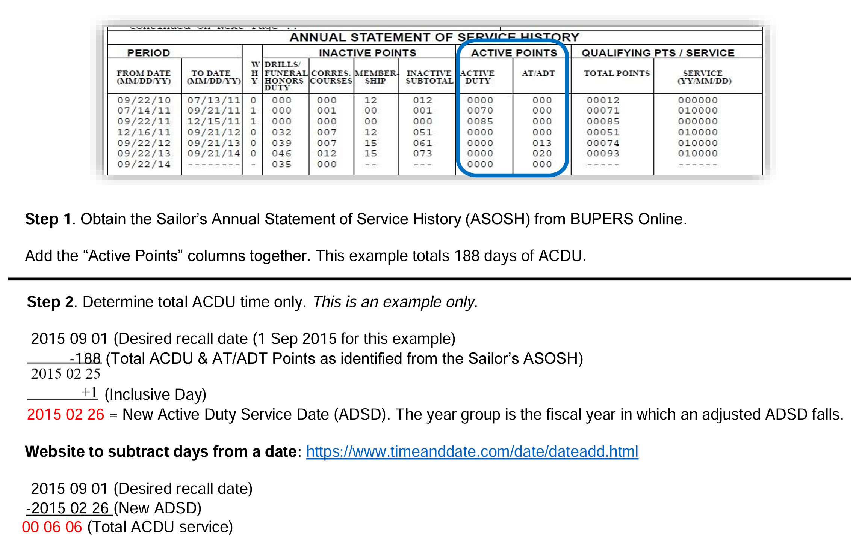
Determining Total Active Service for RC to AC
Notes:
FACILITATOR GUIDE:
Submitting CWAY-TRANSITION for RC to AC/TAR

Slide 33
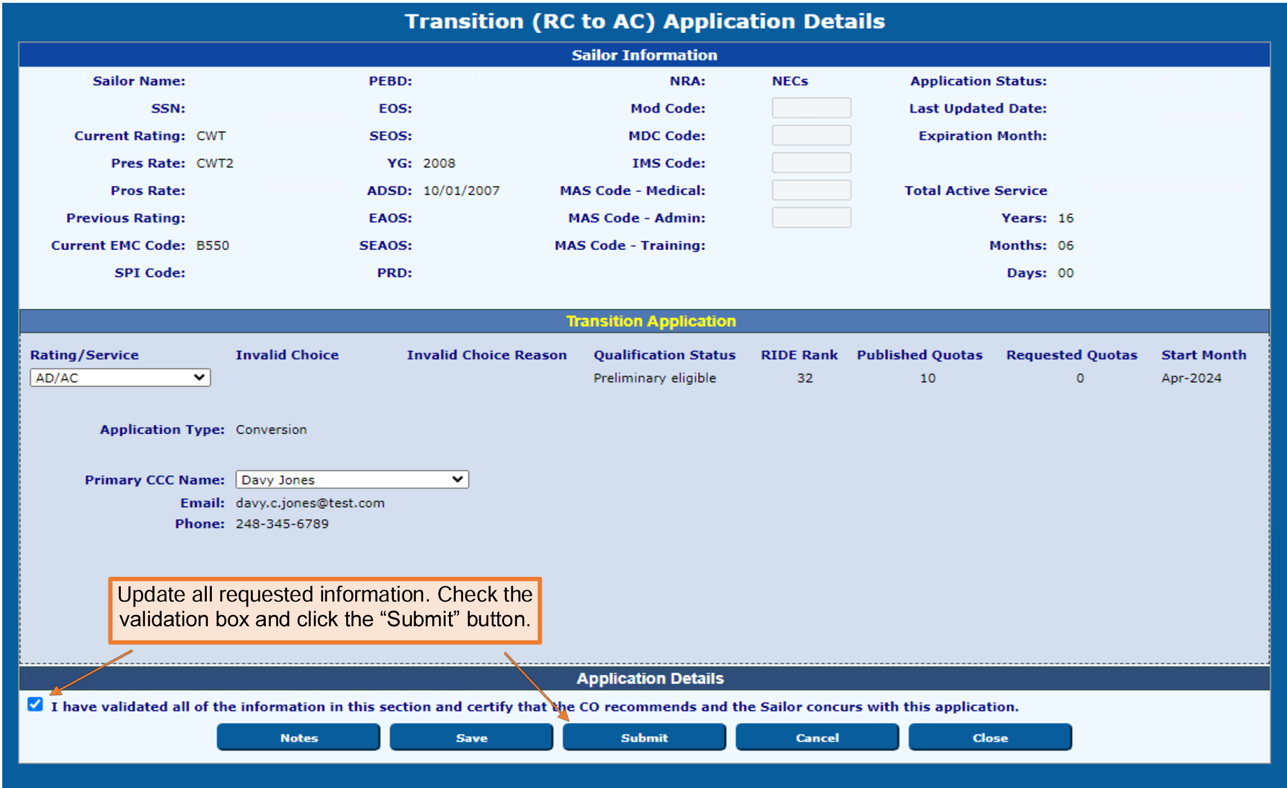
Submitting a CWAY-TRANS Application for RC to AC/TAR (Cont’d.)
Notes:
FACILITATOR GUIDE:
Submitting CWAY-TRANSITION for RC to AC/TAR
Once everything has been validated, click Submit.
To check to the status of your RC to AC/TAR application, head over to the Transition (RC to AC) Application Browser. Ensure to put in the date you applied the Sailor for, or else it will not be listed.

Slide 34
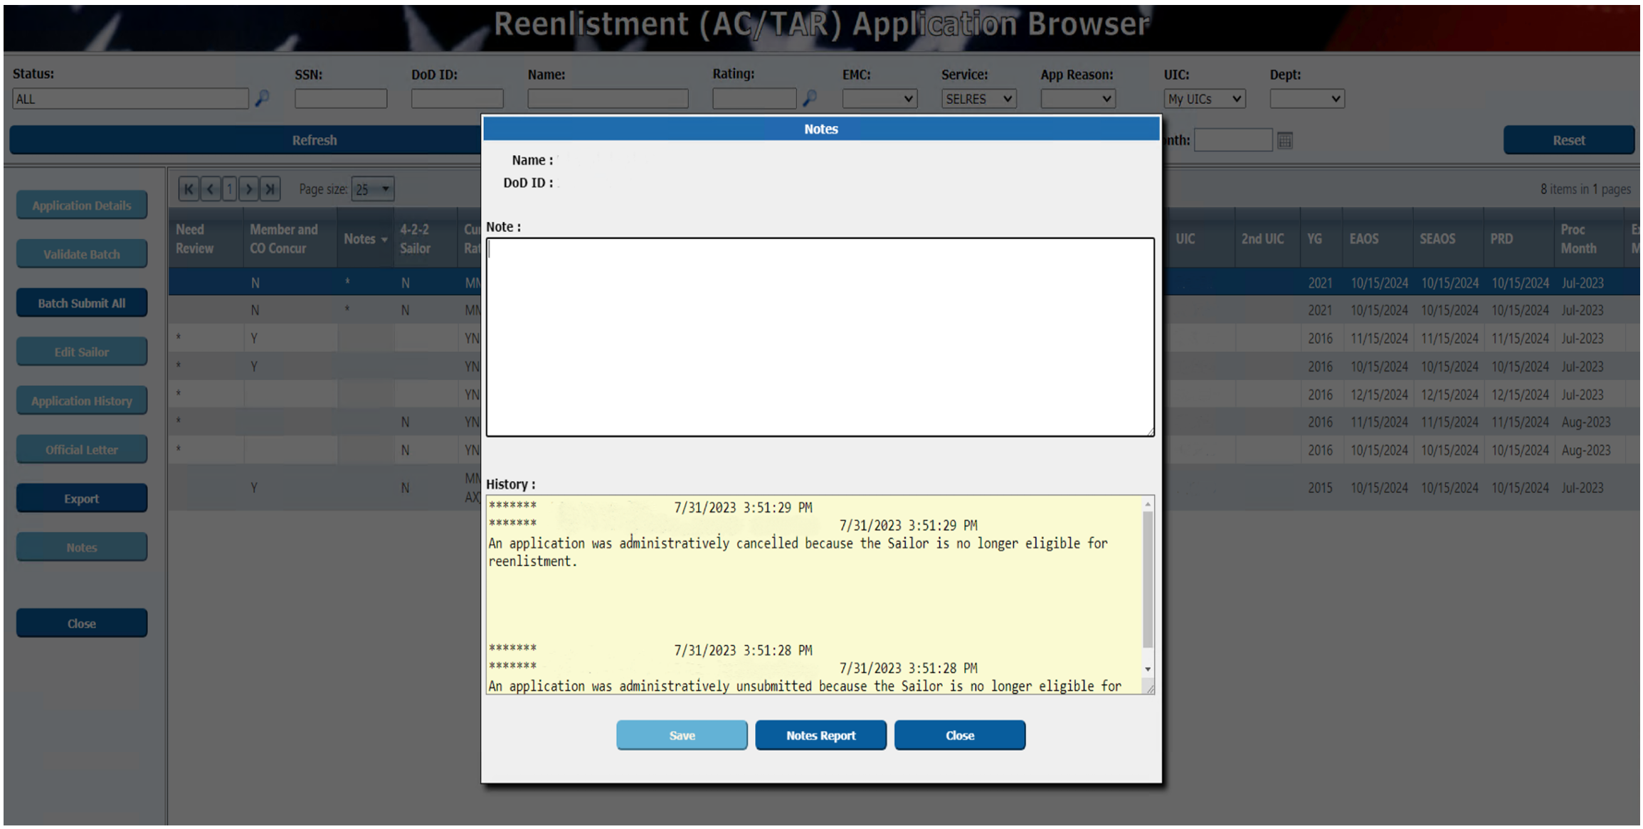
CWAY Notes Section
Notes:
FACILITATOR GUIDE:
The “Notes” section of CWAY is intended as an opportunity to allow communication between the Career Counselors and the Enlisted Community Managers. If the Sailor recently earned his/her warfare device or NEC and it is not reflected in the CWAY “Sailor Details” page, verify receipt and make a note.
1. To either input notes or see if ECM has made any notes (reminder the notes section is where you as the CCC can communicate to the ECM), hover over Sailors, Sailor browser, may need to change page size of 25 to 500 in order to show all Sailors based on the UIC(s) access you have and find the Sailor you are looking for. Click on Sailor's name to get it highlighted in blue, then click on notes. This is where you add or view notes to the Sailor's ECM.
2. Remember this section is your opportunity to communicate with the ECM. Ensure to add notes for applications that are special circumstance, not eligible, and no apply (document everything that affects a change in the Sailor’s application).
3. In this example, the CCC made changes to the Sailor's AFCT scores and annotated the reason why she made said changes.

Slide 35
Targeted Reentry Program (TRP)
MILPERSMAN 1001-260
COs have the ability to recommend their most qualified Sailors the option for expedited re-entry to Active Duty
Sailor Options:
  Golden Ticket
  Silver Ticket
CCCs will submit TRP applications in CWAY:
  Must be the first CWAY application window and submitted as: Intend to Separate
Notes:
FACILTIATOR GUIDE:
1. Golden ticket guaranteed expedited return within one year of separation, after one year will automatically be converted to a Silver ticket for one additional year. Silver ticket Sailors are afforded an expedited return within two years of separation, opportunity is subject to Needs of the Navy.
2. Eligibility: applications must be "Intends to separate" from the onset of the SEAOS application. Members in paygrades E4-E6, must have completed their eight year military service obligation (MSO), be under 14 years of service, and not have reached HYT. BUPERS-3 is the approving authority. Must have neither been awarded NJP or court martial within 3 years prior to release. Sailors who are approved and accept TRP will be transferred to the Standby Reserve- Inactive (USNR-S2).
3. After TRP expiration and MSO is not complete, the service member must accept enlistment into the Individual Ready Reserve active status pool (IRR-ASP).

Slide 36
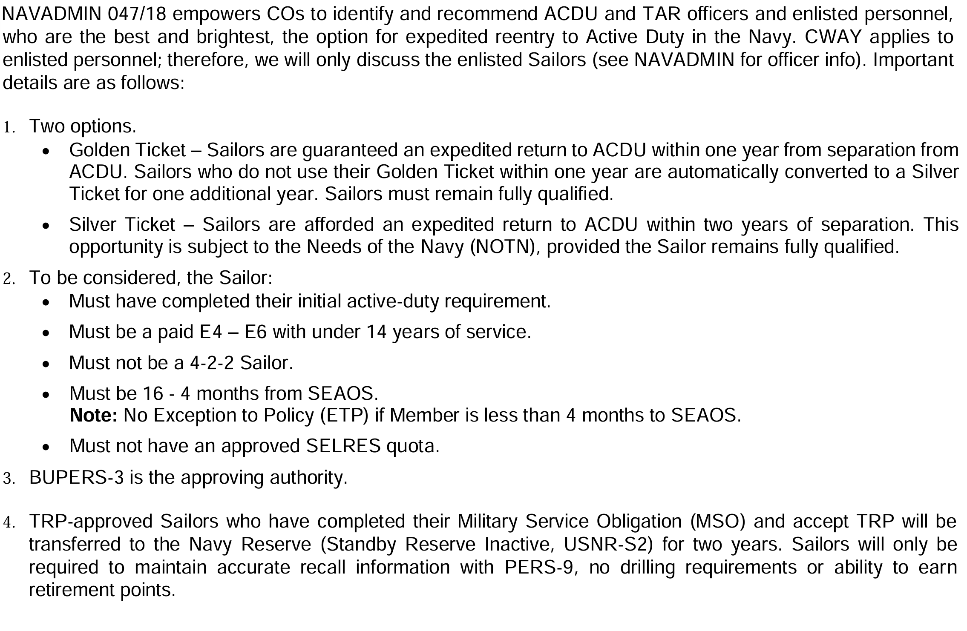
Targeted Reentry Program (TRP)
Notes:
FACILITATOR GUIDE:
The TRP module supports the Targeted Reentry Program through which Active and Full-Time Support Sailors indicate their intention to separate at the end of their current enlistment contract and request authorization for deferred reenlistment. When approved, Sailors may reenlist within a specified period in a highly streamlined process. Submission is constrained by quota availability and other factors.

Slide 37
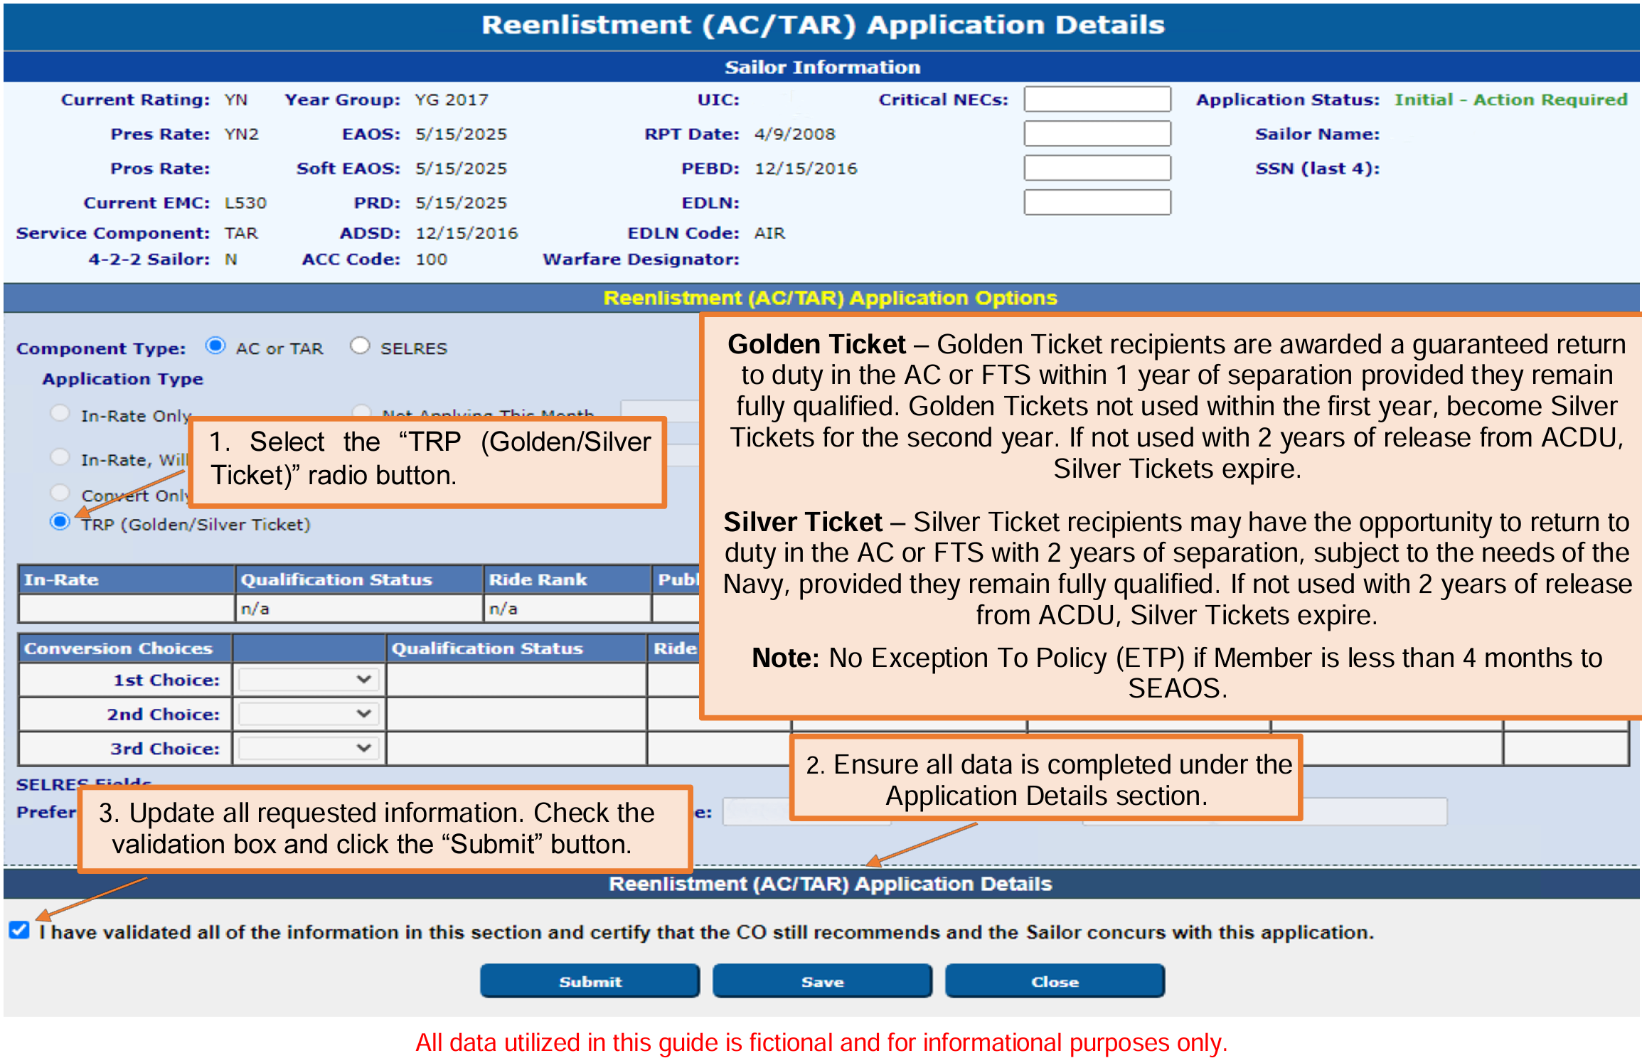
Submitting a TRP Application
Notes:
FACILITATOR GUIDE:
The TRP module supports the Targeted Reentry Program through which Active and Full-Time Support Sailors indicate their intention to separate at the end of their current enlistment contract and request authorization for deferred reenlistment. When approved, Sailors may reenlist within a specified period in a highly streamlined process. Submission is constrained by quota availability and other factors.

Slide 38
Summary and Review
In this lesson we discussed:
  Purpose of Career Waypoints
  Personnel impacted by the Career Waypoints process
  Career Waypoints process
  Career Waypoints options provided to the Sailor
  Career Waypoints timeline requirements
  PACT Marketplace process

Slide 39

Career Waypoints/PACT

